Slide 1
UpGrad and IIIT-B Machine Learning & AI Program
LENDING CLUB CASE STUDY
Participants:
Tarun Khaneja
Hitain Kakkar
Submission:
December 2023

Slide 2
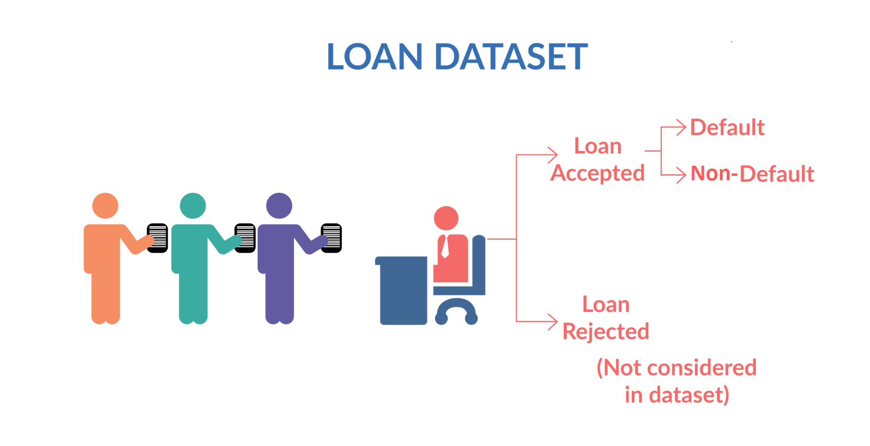
Problem Statement -
You work for a consumer finance company which specializes in lending various types of loans to urban customers. When the company receives a loan application, the company has to make a decision for loan approval based on the applicant’s profile. Two types of risks are associated with the bank’s decision:
If the applicant is likely to repay the loan, then not approving the loan results in a loss of business to the company
If the applicant is not likely to repay the loan, i.e. he/she is likely to default, then approving the loan may lead to a financial loss for the company
The aim is to identify patterns which indicate if a person is likely to default, which may be used for taking actions such as denying the loan, reducing the amount of loan, lending (to risky applicants) at a higher interest rate, etc.

Slide 3
Analysis approach -
Lending money to the risky applicants might be financial loss which is credit loss.
The below approach is used to analyze different types of applicants with various factors which will make it easy to
identify the risk and avoid financial loss.
Data Understanding
Data Cleaning
Removing Outliers
Univariate Analysis
Summary
& Observation
Correlation
Bivariate Analysis
Segmented Analysis

Slide 4
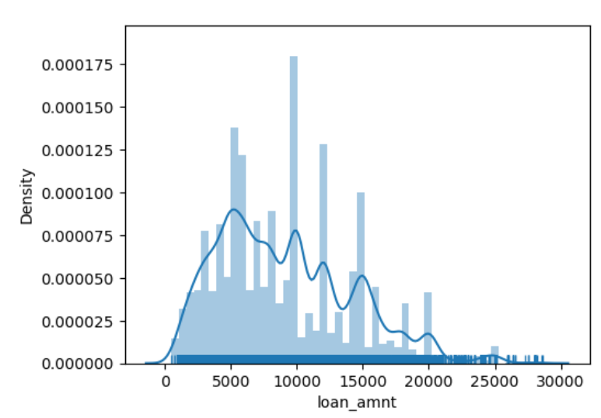
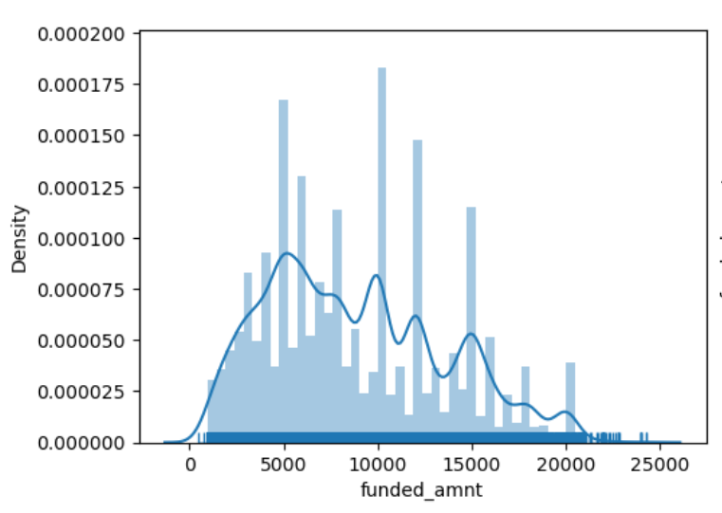
Analysis -
Plot and Data shows -
Most of the loans fall within the range of 5,000 to 15,000
The dataset spans from a minimum loan amount of 500 to a maximum of 28625.
Plot and Data shows -
The average funded amount is approximately 8855
Funded amounts range from a minimum of 500 to a maximum of 24250.

Slide 5
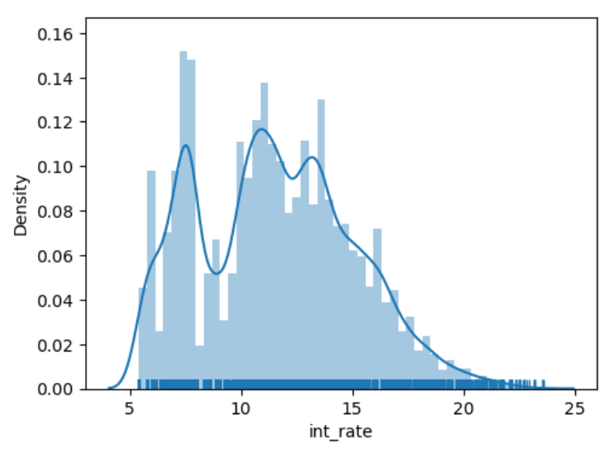
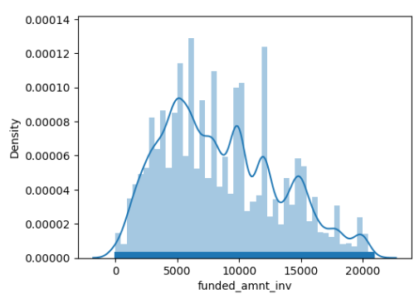
Analysis -
Plot and Data shows -
The average interest rate across loans is approximately 12%
Interest rates range from a minimum of 5.42% to a maximum of 23.59%.
Plot and Data shows -
The average funded amount by investors is approximately 8500
The majority of funded amounts by investors fall within the range of 5,000 to 12,000 (approx.)

Slide 6
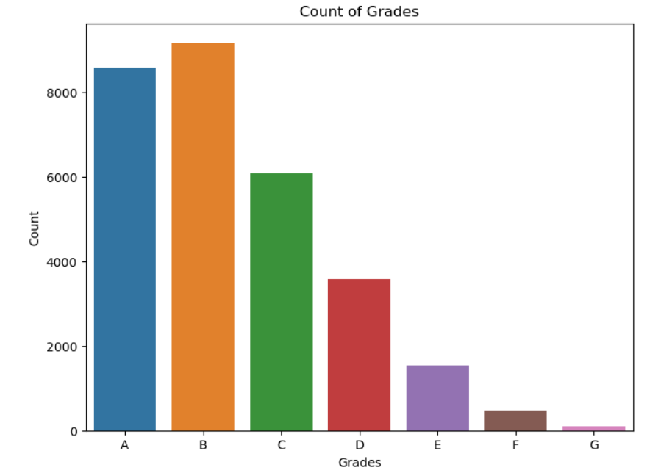
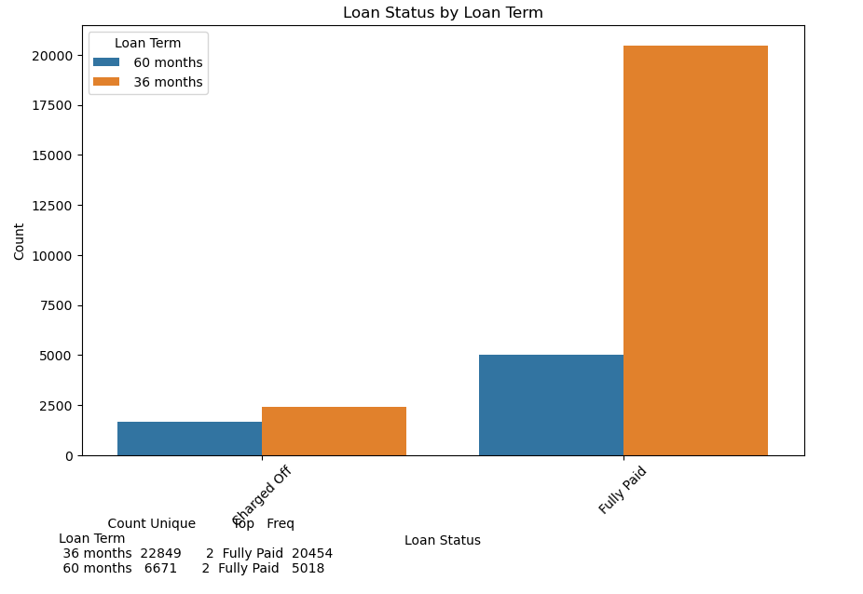
Analysis -
Plot and Data shows -
There are total 29520 entries in the 'grade' column.
There are seven unique grades (A, B, C, D, E, F, G).
The most frequent grade in the dataset is 'B', appearing 9171 times.
Plot and Data shows -
Applicants with term of 36 months have higher chances of paying the loan

Slide 7
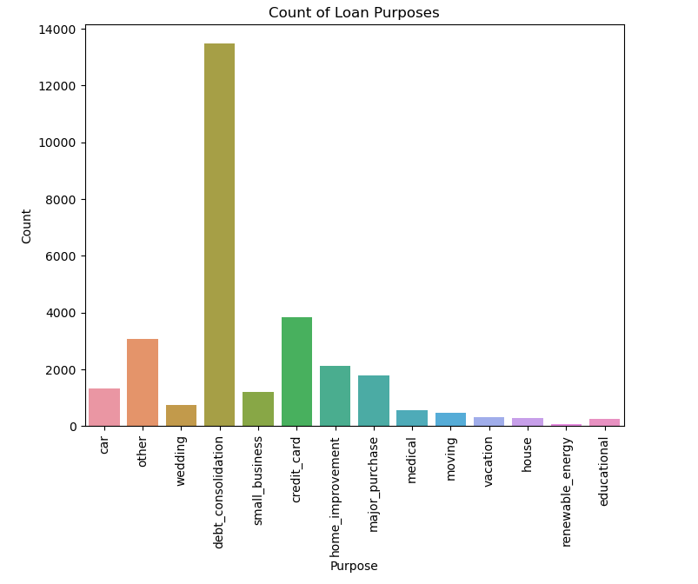
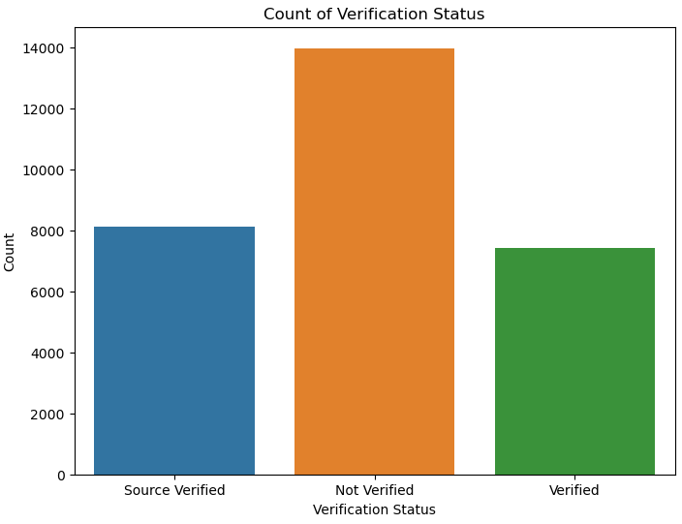
Analysis -
Plot and Data shows -
The greater number of people took loan for _debt consolidation_ and a very few people took for _renewable energy_
Plot and Data shows -
Majority of loans were given without verification of applicant's income.

Slide 8
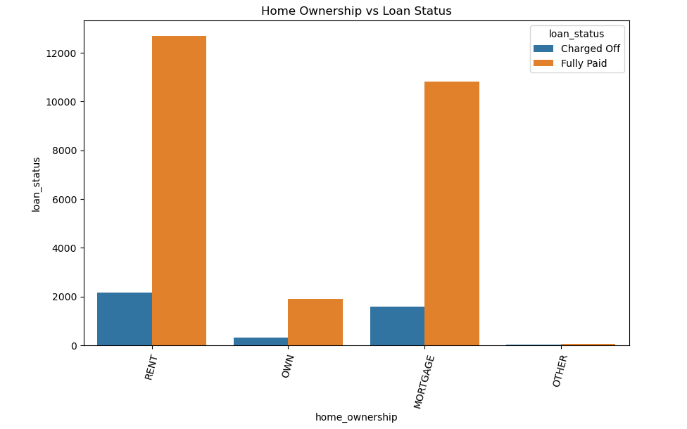
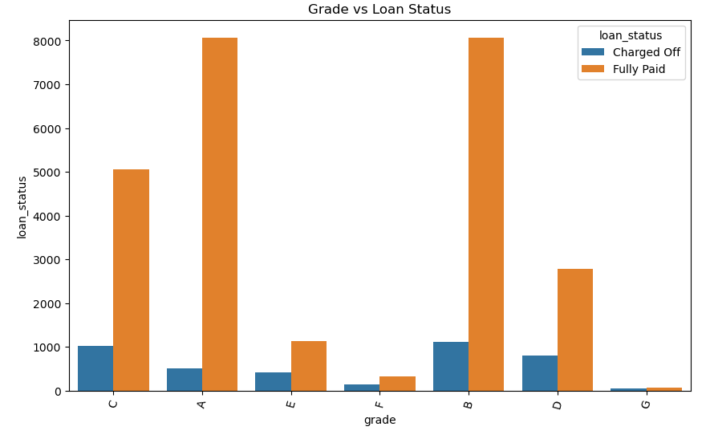
Analysis -
Plot and Data shows -
Charged Off Loans:
Renters (RENT) and Mortgage seems to constitute a significant proportion among borrowers with charged-off loans, indicating a higher risk associated with this category.
Large number of loans taken by with home ownership as Rent and Mortgage, So, there are defaulter as well.
Fully Paid Loans:
Borrowers who have fully paid their loans predominantly belong to the Mortgage and Rent categories, showing stability in these homeownership statuses.
Owned homes (OWN) also show a considerable presence among fully paid loans, suggesting a relatively stable repayment behavior among this group.
Plot and Data shows -
Grade Impact: The majority of loans are classified under 'B' grade, while 'Fully Paid' loans dominate the dataset in terms of loan status.
Higher grades has high possibility of Fully paid off for loan among all the categories like B & A

Slide 9
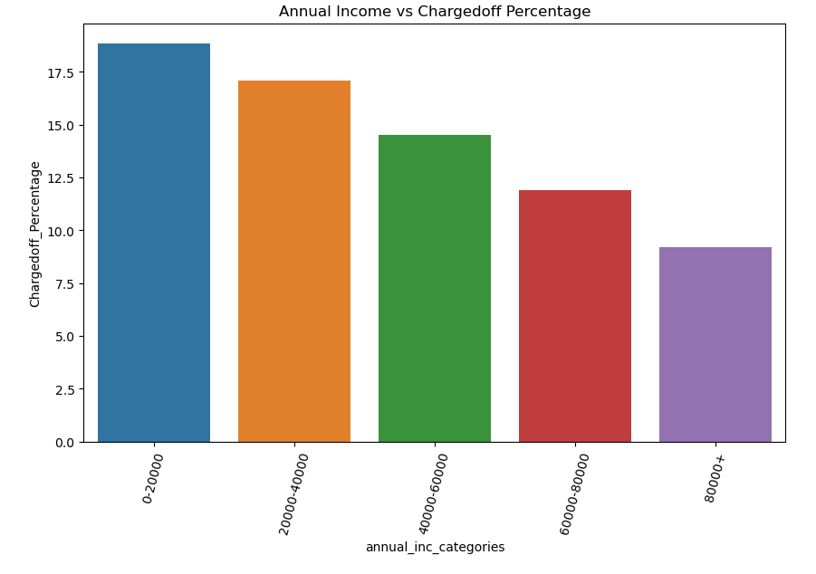
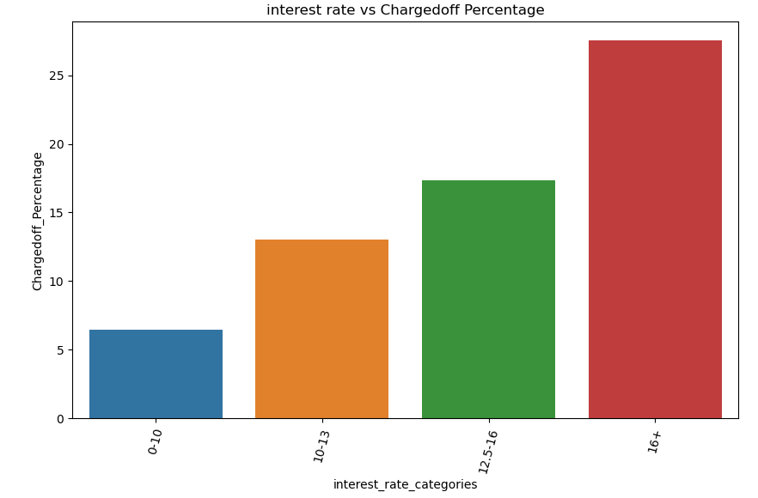
Analysis -
Plot and Data shows -
Income range 80000+ has less chances of charged off.
Income range 0-20000 has high chances of charged off.
More the income less chances of charged off.
Plot and Data shows -
Interest rate more than 16% has good chances of charged off as compared to other category interest rates.
Charged off proportion is increasing with higher interest rates.

Slide 10
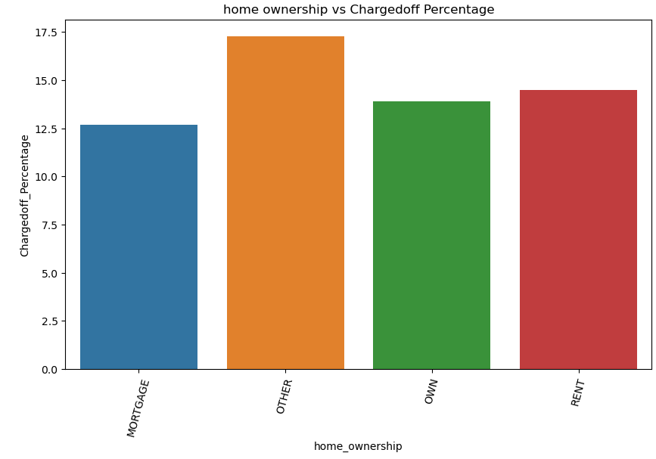
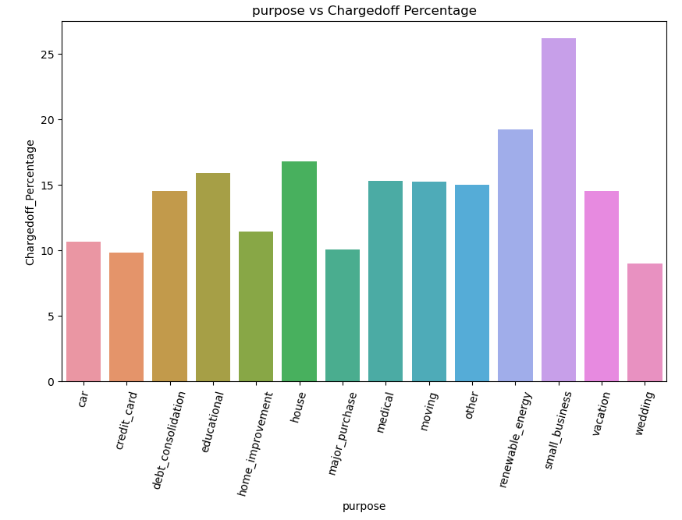
Analysis -
Plot and Data shows -
People who are not owning the home is having high chances of loan charged off.
Plot and Data shows -
Those applicants who are taking loan for wedding is having low chances of charged off.
Those applicants having loan for small business is having high chances for charged off.

Slide 11
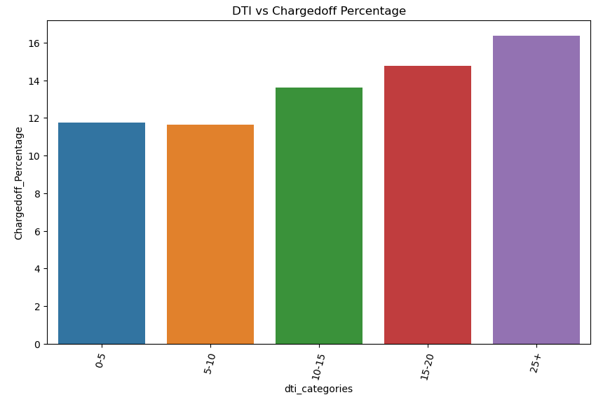
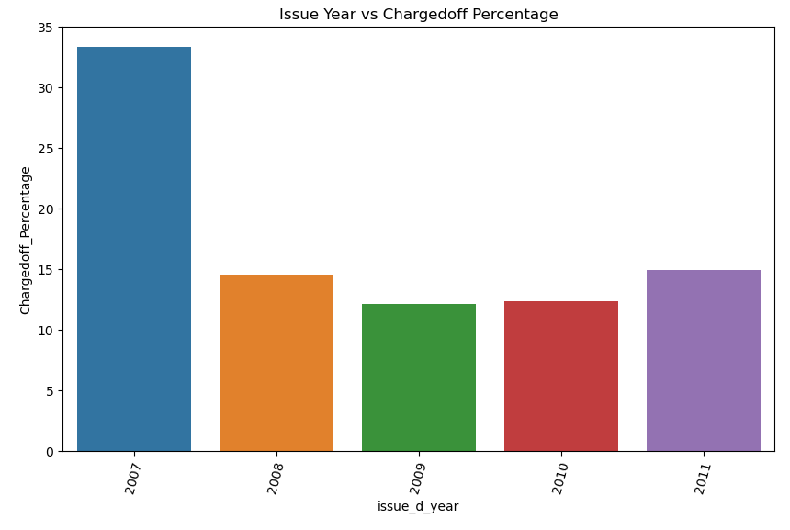
Analysis -
Plot and Data shows -
Higher DTI ratio having high risk of charged off
Lower the DTI ratio having low chances of charged off
Plot and Data shows -
There was highly charged off in year 2007
There was least charged off in year 2009

Slide 12
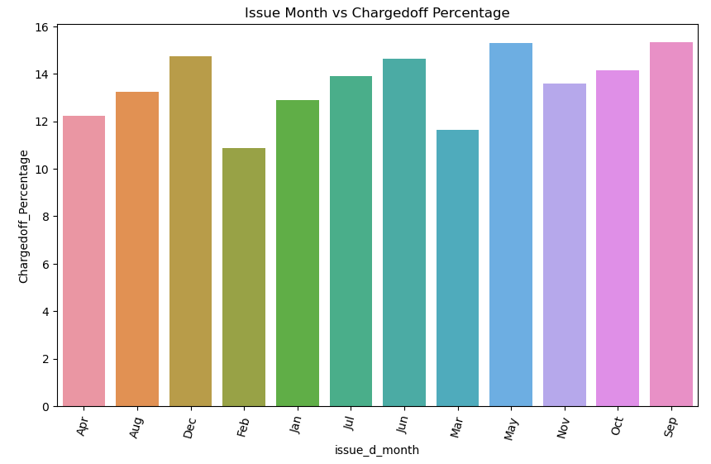
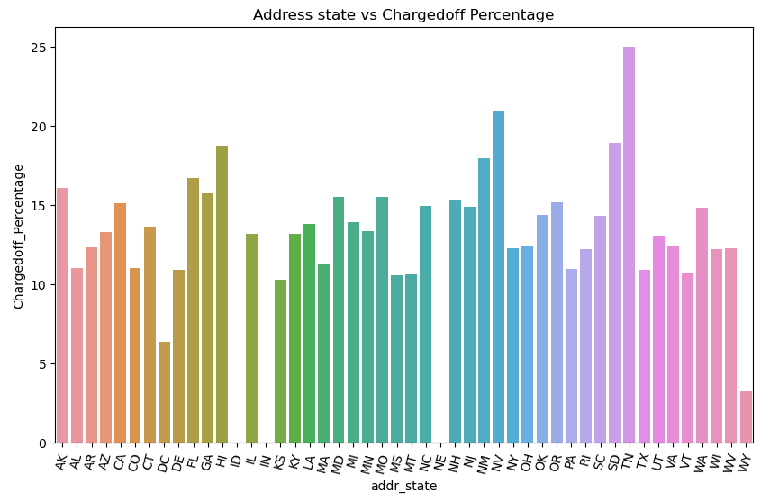
Analysis -
Plot and Data shows -
The loan issued in month of Dec, May, and Sep has charged off more
The loan issue in month of Feb has charged off less
Plot and Data shows -
TN, NV state has highest number of defaults
NE, IN, ID has zero defaults

Slide 13
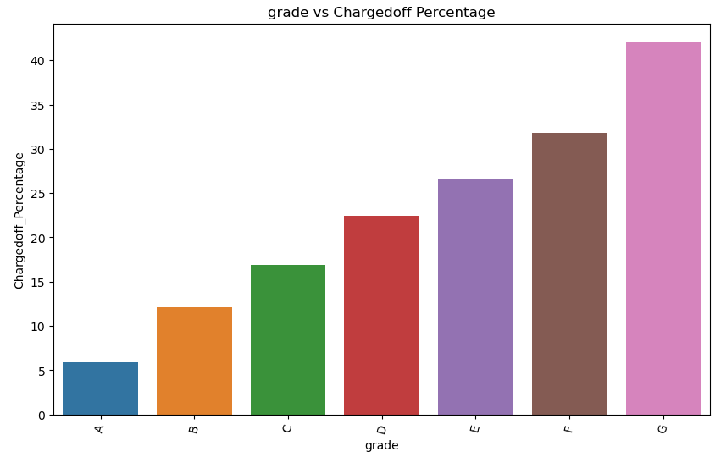
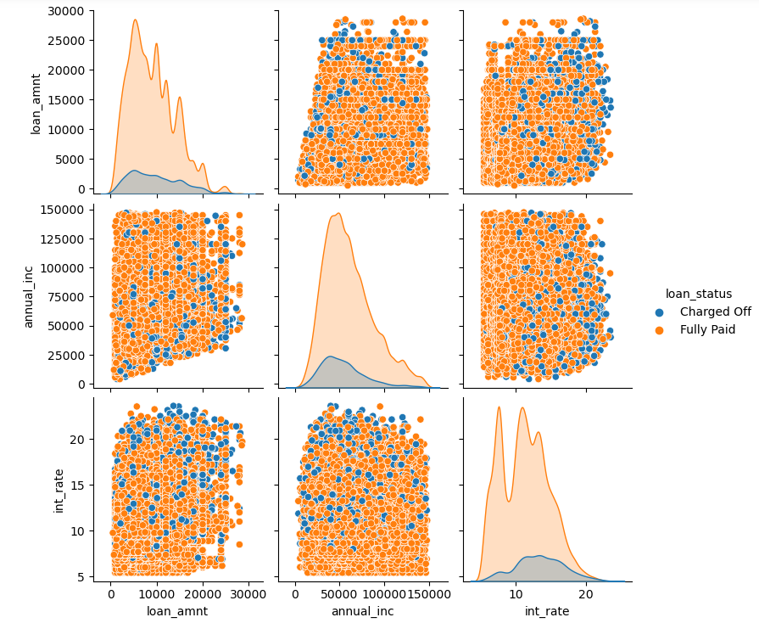
Analysis -
Plot and Data shows -
Loan for G grade has highest defaults
Laon for A grade has least defaults
Plot and Data shows -
There's a wide range of loan amounts approved, potentially indicating varying credit needs among borrowers. Higher annual incomes generally seem to align with larger loan amounts, suggesting that individuals with higher incomes might be approved for more substantial loans.
The interest rates provided for loans vary, but it's not clear from this summary whether higher loan amounts consistently lead to higher interest rates.
It's possible that higher-risk borrowers might receive loans at higher interest rates.

Slide 14
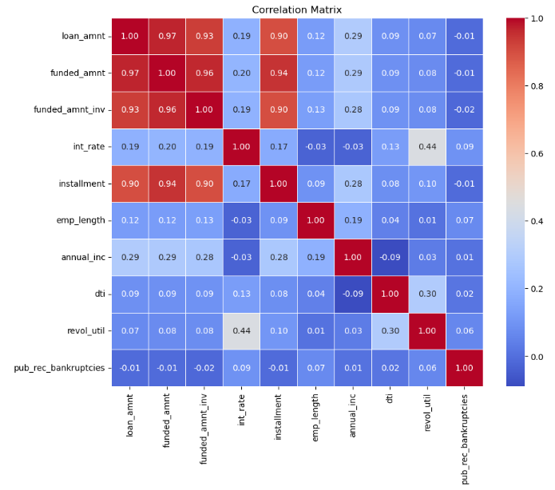
Analysis -
Plot and Data shows -
Interest Rate vs. Loan Amount: Higher loan amounts might correlate with higher interest rates, indicating a potential association between the amount borrowed and the interest charged.
Debt-to-Income Ratio (DTI) vs. Loan Amount: A higher DTI might be associated with lower approved loan amounts, indicating that individuals with higher existing debt might be approved for lower loan amounts.
Annual Income vs. Loan Amount: Generally, higher annual incomes could correlate with higher approved loan amounts, reflecting an ability to repay larger loans.
Employment Length vs. Loan Amount: Longer employment lengths might be associated with higher approved loan amounts, showcasing a potential preference for more stable employment histories when lending larger sums.
Revolving Utilization vs. Loan Amount: Higher revolving credit utilization might correlate with lower approved loan amounts, as lenders might be cautious about extending additional credit to those utilizing a larger percentage of their available credit.
Public Record Bankruptcies vs. Loan Amount: A higher number of public record bankruptcies might correlate with smaller approved loan amounts or even loan denials, indicating a risk-averse approach by lenders towards individuals with such credit history.

Slide 15
Summary -
Applicant’s who don’t own home are risky and there are high chances of loan defaults.
More number of loan is given to non-verified applicant's which may leads to higher risk of defaults.
Applicant's having less annual income have high chances of defaults.
Loan taken for small business and followed by renewable energy leads to higher risk of defaults.
The more the DTI ratio, more the risk of being default.
Month May, September and December shows higher number of defaulter, can be because of higher number of loans sanctioned as well.
Lower the grade having high risk of defaults.
Lesser the employment length, more the interest rate which means there is more chances of default if employment length is small.
Higher the loan term leads to higher chances of loan default.
Applicants from state TN, NV state leads to higher chances of default.
Driving Factors -
Home Ownership | Grade
Annual Income | Employment length
Loan Purpose | Loan term
DTI ratio | State
Month of year | Verification Status

Slide 16
Recommendations -
Lending club should target the applicants with higher income leads to less chances of default.
More number of loan should be provided for wedding rather than small business.
If DTI ratio is high, it means its high risk and should avoid to approve loan for large amount.
Lending club should target Higher Grade like “A” to provide loan, which will help in increase in business financial values.
Applicant’s who has higher employment length and high salary should be given loan of large amount which may leads to high profits.
Lending club should target more applicants from state NE, IN and ID which have negligible defaults.
All the applicants should be verified before approving loan may reduce risk significantly.
Lending money for less tenure can reduce the risk of defaults.

